Slide 1
Computer Networks The Network Layer
Adrian Sergiu DARABANT
Lecture 7

Slide 2
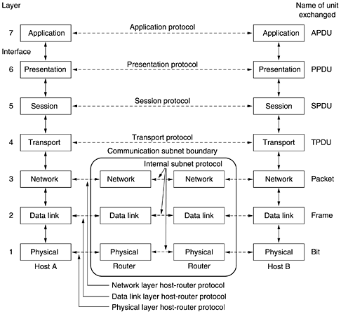
The Network Layer

Slide 3
The Internet Protocol -IP
The Internet (IP) Protocol
IPv4 addressing
Moving a datagram from source to destination
Datagram format
IP fragmentation
ICMP: Internet Control Message Protocol
DHCP: Dynamic Host Configuration Protocol
NAT: Network Address Translation
Routing

Slide 4
The Internet Network Layer
Transport layer: TCP, UDP
Routing protocols
path selection
RIP, OSPF, BGP
IP protocol
addressing conventions
datagram format
packet handling conventions
Network
layer
forwarding
table
ICMP protocol
error reporting
router “signaling”
Link layer
physical layer

Slide 5
IP Addressing
223.1.1.1
IP address: 32-bit identifier for host, router interface
interface: connection between host/router and physical link
router’s typically have multiple interfaces
host may have multiple interfaces
IP addresses associated with each interface
223.1.2.1
223.1.1.2
223.1.1.4
223.1.2.9
223.1.2.2
223.1.1.3
223.1.3.27
223.1.3.1
223.1.3.2
223.1.1.1 = 11011111 00000001 00000001 00000001
223
1
1
1

Slide 6
IP Addressing
IP address:
network part (high order bits)
host part (low order bits)
What’s a network ? (from IP address perspective)
device interfaces with same network part of IP address
can physically reach each other without intervening router=no crossroads
223.1.1.1
223.1.2.1
223.1.1.2
223.1.1.4
223.1.2.9
223.1.1.3
223.1.2.2
223.1.3.27
LAN
223.1.3.1
223.1.3.2
network consisting of 3 IP networks
(for IP addresses starting with 223,
first 24 bits are network address)

Slide 7
IP Addressing
223.1.1.2
223.1.1.1
223.1.1.4
How to find the networks?
Detach each interface from router, host
create “islands of isolated networks
223.1.1.3
223.1.9.2
223.1.7.0
223.1.9.1
223.1.7.1
223.1.8.1
223.1.8.0
223.1.2.6
223.1.3.27
Interconnected
system consisting
of six networks
223.1.2.1
223.1.2.2
223.1.3.1
223.1.3.2

Slide 8
IP Addresses – Class Full
given the notion of “network”, let’s re-examine IP addresses:
“class-full” addressing:
class
A
0
network
host
1.0.0.0 to
127.255.255.255
B
10
network
host
128.0.0.0 to
191.255.255.255
C
110
network
host
192.0.0.0 to
223.255.255.255
D
1110
multicast address
224.0.0.0 to
239.255.255.255
E
1111
Experimental
240.0.0.0 to
255.255.255.255
32 bits

Slide 9
IP Addressing: CIDR
Classful addressing:
inefficient use of address space, address space exhaustion
e.g., class B net allocates enough addresses for 65K hosts, even if we only have 2K hosts in that network
CIDR: Classless InterDomain Routing
network portion of address of arbitrary length
address format: a.b.c.d/x, where x is # bits in network portion of address
network
part
host
part
11001000 00010111 00010000 00000000
200.23.16.0/23

Slide 10
IP Subnet
Basic concept:
A subset of a class A, B or C network.
IP addresses that do not use subnets consist of
A network portion, and
A host portion.
Represents a static two-level hierarchical addressing model.

Slide 11
IP Subnet (cont)
IP subnets introduces a third level of hierarchy.
A network portion
A subnet portion
A host portion
Allow more efficient (and structured) utilization of the addresses.
Uses network masks.
usually handled together as network
but with substructure

Slide 12
CIDR – Introduction
The size of the global routing tables have grown very fast in recent years.
Caused routers to become saturated.
CIDR is a new concept to manage IP networks.
Classless Inter Domain Routing.
No concept of class A, B, C networks.
Reduces sizes of routing tables.

Slide 13
CIDR - Basic Idea
An IP address is represented by a prefix, which is the IP address of the network.
It is followed by a slash, followed by a number M.
M: number of leftmost contiguous bits to be used for the network mask.
Example: 144.16.192.57 / 18

Slide 14
CIDR - Rules
The number of addresses in each block must be a power of 2.
The beginning address in each block must be divisible by the number of addresses in the block.
A block that contains 16 addresses cannot have beginning address as 193.226.40.36.
But the address 193.226.40.64 is possible !

Slide 15
IP/Netmask - examples
209.220.186.8/255.255.255.252=>
209.220.186.8
209.220.186.9
209.220.186.10
209.220.186.11
209.220.186.8/255.255.255.248=>
209.220.186.8
209.220.186.9
209.220.186.10
209.220.186.11
209.220.186.12
209.220.186.13
209.220.186.14
209.220.186.15
209.220.186.8/255.255.255.240
Invalid combination

Slide 16
Network masks
Network mask 255.0.0.0 is applied to a class A network 10.0.0.0;
Mask = series of contiguous 1’s followed by a series of contiguous 0’s
11111111 00000000 00000000 00000000
NETWORK
HOST

Slide 17
Natural Masks
Provide a mechanism to split the IP address 10.0.0.20 into:
A network portion – 10;
A host portion – 0.0.20;
IP Address: 10.0.0.20 00001010 00000000 00000000 00010100
Mask: 255.0.0.0 11111111 00000000 00000000 00000000
Network Host

Slide 18
Natural masks
Class A, B and C addresses
Have fixed division of network and host portions
Can be expressed as masks
Natural Masks
Class A: 255.0.0.0
Class B: 255.255.0.0
Class C: 255.255.255.0

Slide 19
Subnets out of masks
Masks are very flexible.
Using masks, networks can be divided into smaller subnets.
How?
By extending the network portion of the address into the host portion.
Advantage gained:
We can create a large number of subnets from one network.
Can have less number of hosts per network.

Slide 20
Network Address
Network Mask
255.255.255.0
IP Address
193.226.40.45
Network Address
193.226.40.0
AND
Network Mask
255.255.255.224
IP Address
193.226.40.45
Network Address
193.226.40.32
Network Address
?
AND

Slide 21
Subnetting
Basic concept
The same network can be configured with different masks.
Can have subnets of different sizes.
Allows better utilization of available addresses.

Slide 22
Example
Suppose we are assigned a Class C network 193.226.40.0
To be divided into three subnets.
Corresponding to three departments.
With 110, 45 and 50 hosts respectively
D1
110
D2
45
D3
50

Slide 23
Example (cont) - Options
X | X(binary) | # of Subnets | # of Hosts
128 | 1000 0000 | 2 | 128
192 | 1100 0000 | 4 | 64
224 | 1110 0000 | 8 | 32
240 | 1111 0000 | 16 | 16
248 | 1111 1000 | 32 | 8
252 | 1111 1100 | 64 | 4
254 | 1111 1110 | 128 | 2
Network too small
Rules:
First IP address = Network Address
Last IP address = Broadcast Address

Slide 24
How does one get IP Addresses ?
Q: How does a network get the network part of IP addr?
A: it gets allocated from the portion of its provider ISP’s address space
ISP's block 11001000 00010111 00010000 00000000 200.23.16.0/20
Organization 0 11001000 00010111 00010000 00000000 200.23.16.0/23
Organization 1 11001000 00010111 00010010 00000000 200.23.18.0/23
Organization 2 11001000 00010111 00010100 00000000 200.23.20.0/23
... ….. …. ….
Organization 7 11001000 00010111 00011110 00000000 200.23.30.0/23

Slide 25
Supernetting
Organization 0
200.23.16.0/23
Organization 1
200.23.18.0/23
“Send me anything with addresses beginning
200.23.16.0/20”
Organization 2
200.23.20.0/23
.
ISP
.
.
.
.
Internet
Organization 7
.
Multiple Routing entries become a single one !
200.23.30.0/23
Organization 8
200.23.16.0/20
200.23.32.0/24
?
?
200.23.32.0/24
Two routes
Supernetting aggregates routes !

Slide 26
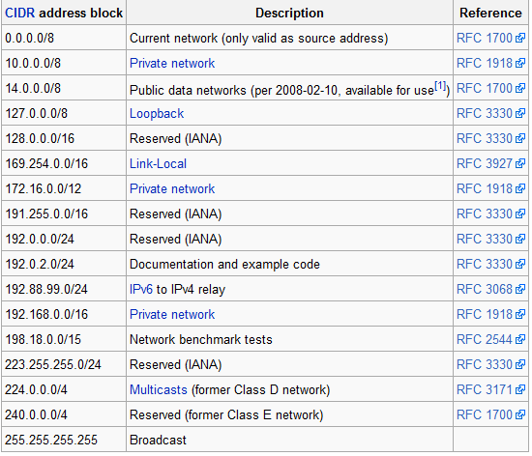
Reserved Addresses

Slide 27
Private Addreses
Name | IP address range | number of IPs | classful description | largest CIDR block | defined in
24-bit block | 10.0.0.0 – 10.255.255.255 | 16,777,216 | single class A | 10.0.0.0/8 | RFC 1597 (obsolete), RFC 1918
20-bit block | 172.16.0.0 – 172.31.255.255 | 1,048,576 | 16 contiguous class Bs | 172.16.0.0/12
16-bit block | 192.168.0.0 – 192.168.255.255 | 65,536 | 256 contiguous class Cs | 192.168.0.0/16
Not routed in Internet
Why ?

Slide 28
Routing tables (static)
Destination | Gateway | Genmask | Flags | Metric | Ref | Use | Iface
172.16.25.1 | 172.30.0.4 | 255.255.255.255 | UGH | 0 | 0 | 0 | Eth1
193.226.40.128 | 0.0.0.0 | 255.255.255.224 | U | 0 | 0 |  | Eth0
193.0.225.0 | 0.0.0.0 | 255.255.255.0 | U | 0 | 0 |  | Eth0
193.231.20.0 | 0.0.0.0 | 255.255.255.0 | U | 0 | 0 |  | Eth0
172.30.0.0 | 0.0.0.0 | 255.255.0.0 | U | 0 | 0 |  | Eth1
169.254.0.0 | 0.0.0.0 | 255.255.0.0 | U | 0 | 0 |  | Eth1
0.0.0.0 | 193.0.225.9 | 0.0.0.0 | UG | 0 | 0 |  | Eth0
The route command – (Windows/Linux/other OS)

Slide 29
Datagram: from source to destination
forwarding table in A
Dest Net | Mask | Nxt Router | Metric
223.1.1.0 | 255.255.255.0 |  | 1
223.1.2.0 | 255.255.255.0 | 223.1.1.4 | 2
223.1.3.0 | 255.255.255.0 | 223.1.1.4 | 2
64.8.32.1 | 255.255.255.255 | 223.1.1.10 | 2
IP datagram:
misc
fields
source
IP addr
dest
IP addr
data
A
223.1.1.1
datagram remains unchanged, as it travels source to destination
Addresses are fields of interest here
223.1.2.1
223.1.1.2
223.1.1.4
223.1.2.9
B
223.1.2.2
E
223.1.1.3
223.1.3.27
223.1.3.1
223.1.3.2

Slide 30
Datagram: from source to destination
forwarding table in A
misc
fields
Dest Net | Mask | Nxt Router | Metric
223.1.1.0 | 255.255.255.0 |  | 1
223.1.2.0 | 255.255.255.0 | 223.1.1.4 | 2
223.1.3.0 | 255.255.255.0 | 223.1.1.4 | 2
64.8.32.1 | 255.255.255.255 | 223.1.1.10 | 2
223.1.1.1
223.1.1.3
data
Starting at A, send IP datagram addressed to B:
look up net. address of B in forwarding table
find B is on same net. as A
link layer will send datagram directly to B inside link-layer frame
B and A are directly connected
A
223.1.1.1
223.1.2.1
223.1.1.2
223.1.1.4
223.1.2.9
B
223.1.2.2
E
223.1.1.3
223.1.3.27
223.1.3.1
223.1.3.2

Slide 31
Datagram: from source to destination
forwarding table in A
misc
fields
223.1.1.1
223.1.2.3
data
Dest Net | Mask | Nxt Router | Metric
223.1.1.0 | 255.255.255.0 |  | 1
223.1.2.0 | 255.255.255.0 | 223.1.1.4 | 2
223.1.3.0 | 255.255.255.0 | 223.1.1.4 | 2
64.8.32.1 | 255.255.255.255 | 223.1.1.10 | 2
Starting at A, dest. E:
look up network address of E in forwarding table
E on different network
A, E not directly attached
routing table: next hop router to E is 223.1.1.4
link layer sends datagram to router 223.1.1.4 inside link-layer frame
datagram arrives at 223.1.1.4
continued…..
A
223.1.1.1
223.1.2.1
223.1.1.2
223.1.1.4
223.1.2.9
B
223.1.2.2
E
223.1.1.3
223.1.3.27
223.1.3.1
223.1.3.2

Slide 32
Datagram: from source to destination
forwarding table in router
misc
fields
Dest Net | Mask | Nxt R | Metric | Interface
223.1.1.0 | 255.255.255.0 | - | 1 | 223.1.1.4
223.1.2.0 | 255.255.255.0 | - | 1 | 223.1.2.9
223.1.3.0 | 255.255.255.0 | - | 1 | 223.1.3.27
223.1.1.1
223.1.2.3
data
Arriving at 223.1.4, destined for 223.1.2.2
look up network address of E in router’s forwarding table
E on same network as router’s interface 223.1.2.9
router, E directly attached
link layer sends datagram to 223.1.2.2 inside link-layer frame via interface 223.1.2.9
datagram arrives at 223.1.2.2!!! (hooray!)
A
223.1.1.1
223.1.2.1
223.1.1.2
223.1.1.4
223.1.2.9
B
223.1.2.2
E
223.1.1.3
223.1.3.27
223.1.3.1
223.1.3.2

Slide 33
IP Datagram
IP protocol version
number
32 bits
total datagram
length (bytes)
header length
(bytes)
head.
Len(4)
type of
Service(8)
Ver(4)
Length(16)
13 bit fragment
offset(13)
for
fragmentation/
reassembly
“type” of data
16-bit identifier(16)
Flgs(3)
max number
remaining hops
(decremented at
each router)
time to
Live(8)
upper
layer Prot(8)
Header Internet
checksum(16)
DF+MF
32 bit source IP address(32)
upper layer protocol
to deliver payload to
32 bit destination IP address(32)
Options (if any)
E.g. timestamp,
record route
taken, specify
list of routers
to visit.
how much overhead?
20 bytes of IP
= 20 bytes + upper layer (TCP/UDP) + app layer overhead
data
(variable length,
typically a TCP
or UDP segment)

Slide 34
Fragmentation/Reassembly
network links have MTU (max.transfer size) - largest possible link-level frame.
different link types, different MTUs
large IP datagram divided (“fragmented”) within net
one datagram becomes several datagrams
“reassembled” only at final destination
IP header bits used to identify, order related fragments
fragmentation:
in: one large datagram
out: 3 smaller datagrams
reassembly

Slide 35
Fragmentation/Reassembly
Example
4000 byte datagram
MTU = 1500 bytes
length
=4000
ID
=x
fragflag
=0
offset
=0
One large datagram becomes
several smaller datagrams
length
=1500
ID
=x
fragflag
=1
offset
=0
length
=1500
ID
=x
fragflag
=1
offset
=1480
length
=1040
ID
=x
fragflag
=0
offset
=2960

Slide 36
NAT – Network Address Translation
rest of
Internet
local network
(e.g., home network)
10.0.0/24
10.0.0.1
10.0.0.4
10.0.0.2
138.76.29.7
10.0.0.3
All datagrams leaving local
network have same single source NAT IP address: 138.76.29.7,
different source port numbers
Datagrams with source or
destination in this network
have 10.0.0/24 address for
source, destination (as usual)

Slide 37
NAT – Network Address Translation
Motivation: local network uses just one IP address as far as outside word is concerned:
no need to be allocated range of addresses from ISP: - just one IP address is used for all devices
can change addresses of devices in local network without notifying outside world
can change ISP without changing addresses of devices in local network
devices inside local net not explicitly addressable, visible by outside world (a security plus).

Slide 38
NAT – Network Address Translation
NAT translation table
WAN side addr LAN side addr
1: host 10.0.0.1
sends datagram to
128.119.40.186, 80
138.76.29.7, 5001 10.0.0.1, 3345
…… ……
S: 10.0.0.1, 3345
D: 128.119.40.186, 80
10.0.0.1
1
2
S: 138.76.29.7, 5001
D: 128.119.40.186, 80
10.0.0.4
10.0.0.2
138.76.29.7
S: 128.119.40.186, 80
D: 10.0.0.1, 3345
4
S: 128.119.40.186, 80
D: 138.76.29.7, 5001
3
10.0.0.3
4: NAT router
changes datagram
dest addr from
138.76.29.7, 5001 to 10.0.0.1, 3345
3: Reply arrives
dest. address:
138.76.29.7, 5001

Slide 39
NAT – Network Address Translation
16-bit port-number field:
60,000 simultaneous connections with a single LAN-side address!
NAT is controversial:
routers should only process up to layer 3
violates end-to-end argument
NAT possibility must be taken into account by app designers, e.g., P2P applications
address shortage should instead be solved by IPv6

Slide 40
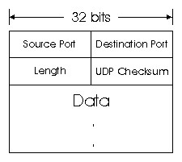
UDP
Checksum – for the entire datagram (header + data)
Length >=8 – entire datagram

Slide 41
ICMP
Used by hosts, routers, gateways to communication network-level information
error reporting: unreachable host, network, port, protocol
echo request/reply (used by ping)
Network-layer “above” IP:
ICMP msgs carried in IP datagrams
ICMP message: type, code plus first 8 bytes of IP datagram causing error

Slide 42
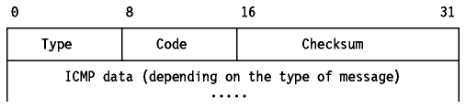
ICMP
Type Code description
0 0 echo reply (ping)
3 0 dest. network unreachable
3 1 dest host unreachable
3 2 dest protocol unreachable
3 3 dest port unreachable
3 6 dest network unknown
3 7 dest host unknown
Type Code description
4 0 source quench (congestion
control - not used)
8 0 echo request (ping)
9 0 route advertisement
10 0 router discovery
11 0 TTL expired
12 0 bad IP header

Slide 43
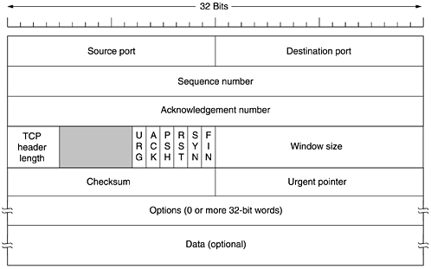
TCP Datagrams

Slide 44
Sequence No – ACK No

